Slide 1

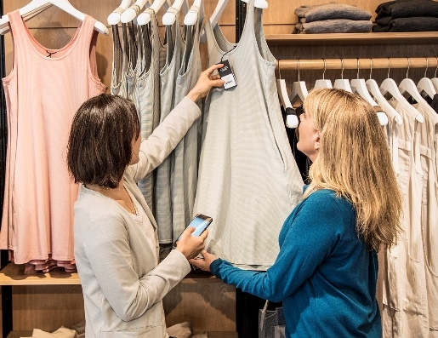



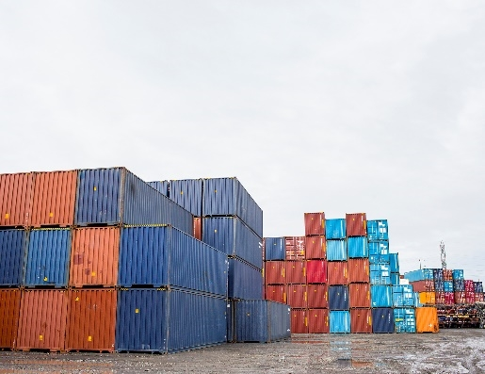

IoT & AI with Microsoft Azure
Martin Raepple
Cloud Solution Architect - Microsoft

Slide 2








Innovations enabling new opportunities
Digital Twins
AI
Cloud
IoT
Edge
Globally available, unlimited compute resources
Harnessing signals from sensors and devices, managed centrally by the cloud
Intelligence offloaded from the cloud to IoT devices
Breakthrough intelligence capabilities, in the cloud and on the edge
Create living replicas of any physical environment, track the past and predict the future

Slide 3
Fueling opportunities
$267 billion
Predicted USD spend on IoT by manufacturers by 2020¹
+$100 million
Average increase operating income among the more digitally transformed enterprises²
94%
Percentage of businesses projected to be using IoT by the end of 2021³
^{Boston Consulting Group, 2017}
^{Keystone Strategy, 2018}
^{Hypothesis, 2019}
80B
Connected “things” by 2025 generating 180ZB of data
$130B
New monetization avenues due to IoT-related services
80%
Companies that increased revenue as a result of IoT implementation
$100M
Average increase in operating income (avg. 8%) among the most digitally transformed enterprises
Notes:
Source
¹ https://www.businessinsider.com/internet-of-things-in-manufacturing-2016-10
² Keystone Strategy interviews October 2015 - March 2016; Incremental operating income of 100M USD is based on median company revenue of 3.4B USD
³ Hypothesis and Microsoft, IoT Signals: Summary of Research Learnings 2019, July 2019

Slide 4

The new era of digitization across industries
Energy
More efficient, cleaner power, and using less of it across industries
Transportation
People and goods moving reliably, more safely, and using less energy
Manufacturing
Realize efficiency, automation, customer centricity and tap into new revenue sources
Agriculture
Better yields and higher quality with fewer resources and less waste
Smart Cities
More sustainable, prosperous, and economically competitive cities
Retail
Better customer experiences,
new market opportunity
Healthcare
Improved quality and better outcomes for patients, anywhere

Slide 5
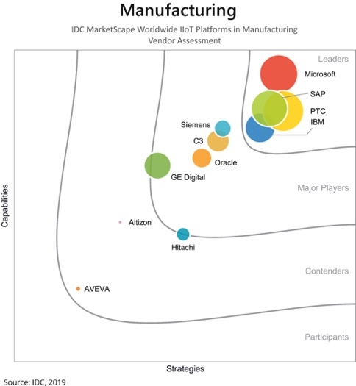
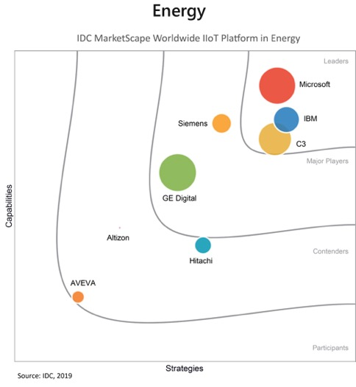
Industry experience drives our platform
Microsoft’s domain strengths as identified by IDC:
Strong momentum within the Industrial IoT sector
Extensive partnerships with IT and OT companies
Broad strategy to support edge computing that spans hardware and software
IDC MarketScape vendor analysis model is designed to provide an overview of the competitive fitness of ICT suppliers in a given market. The research methodology utilizes a rigorous scoring methodology based on both qualitative and quantitative criteria that results in a single graphical illustration of each vendor’s position within a given market. The Capabilities score measures vendor product, go-to-market and business execution in the short-term. The Strategy score measures alignment of vendor strategies with customer requirements in a 3-5-year timeframe. Vendor market share is represented by the size of the circles. Vendor year-over-year growth rate relative to the given market is indicated by a plus, neutral or minus next to the vendor name.
SOURCE: "IDC Marketscape: Worldwide Industrial IoT Platforms in Manufacturing 2019 Vendor Assessment" by Stacy Crook and Reid Paquin, June 2019, IDC #US45116819 and IDC #US45116919
Notes:
Narrative: Microsoft has the industry/domain experience to link technical innovation with success in your field. That experience informs how we design hardware, how we certify vendor partners, and how our cloud operates.
IDC MarketScape vendor analysis model is designed to provide an overview of the competitive fitness of ICT suppliers in a given market. The research methodology utilizes a rigorous scoring methodology based on both qualitative and quantitative criteria that results in a single graphical illustration of each vendor’s position within a given market. The Capabilities score measures vendor product, go-to-market and business execution in the short-term. The Strategy score measures alignment of vendor strategies with customer requirements in a 3-5-year timeframe. Vendor market share is represented by the size of the circles. Vendor year-over-year growth rate relative to the given market is indicated by a plus, neutral or minus next to the vendor name.
SOURCE: "IDC Marketscape: Worldwide Industrial IoT Platforms in Manufacturing 2019 Vendor Assessment" by Stacy Crook and Reid Paquin, June 2019, IDC #US45116819 and IDC #US45116919

Slide 6
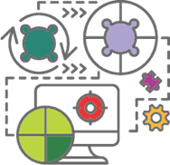

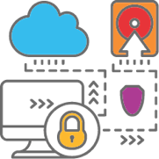
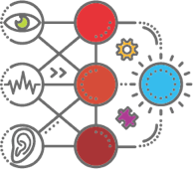
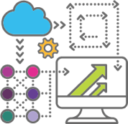

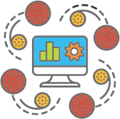
Transformative Solutions for Manufacturing
Get started easily with flexible, scalable solutions to transform your business function
Quality
Assurance
Demand Forecasting
Anomaly Detection
Supply Chain and Inventory Optimization
Connected Devices
Operational Efficiency
Predictive
Maintenance
What are the root causes of recurring problems?
(so I can redesign product, process, training)
What machines are not performing properly?
(so I can immediately investigate)
What sales or usage volume can I expect?
(so I can optimize my staffing and asset utilization)
What is the likelihood this part will fail ?
(so I can prevent it from happening)
What is right level and supplier for a part?
(so I can simplify and optimize procurement)
Are my buildings, plant and equipment working at peak efficiency
(so I can reduce unnecessary costs)
What factories, lines, teams, machines, people…are most effective ?
(so I can identify best practices and allocate resources)
6

Slide 7
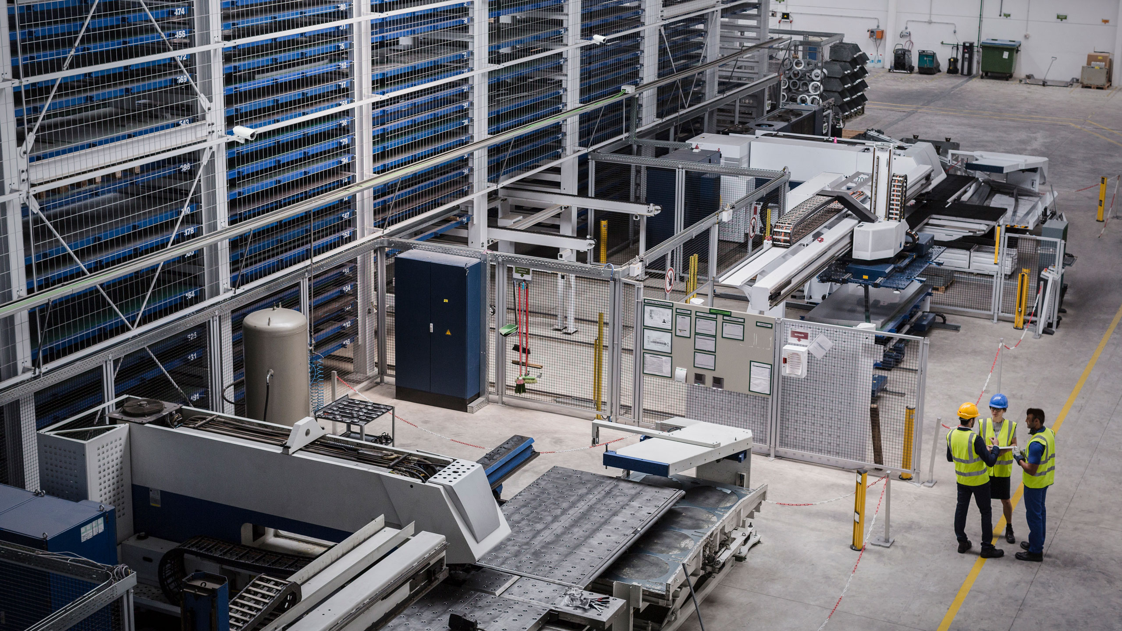
Notes:
A typical factory floor – nothing fancy
Bunch of machinery, some tools
But these also need some protocol – for workplace safety
Can you identify any issues here?

Slide 8

Missing equipment
Flammable equipment near heat source
No hardhat
Notes:
Some issues highlighted here
Cannot always have human supervising these things
Perfect case for Machine Learning
<Transition> Let’s focus on one of these problems and try to solve it as a DS

Slide 9
Missing equipment
Flammable equipment near heat source
No hardhat
Notes:
Let’s pick this issue of an employee not wearing a recommended safety hat on the factory floor.
This is dangerous, and the company can be liable for a lot of money in case of a mishap.

Slide 10
How can we accurately identify hazardous situations with machine learning?
Notes:
How can we build an ML model to solve this problem

Slide 11
Notes:
– these edge cameras now form part of factory floor
Capture images/video which is analyzed locally, as the model was deployed to edge
<Transition to results>
Let’s see what this model can show us

Slide 12
Missing equipment
Flammable equipment near heat source
No hardhat
Notes:
These models can be very helpful
Detect all sorts of objects if trained right
Detect anomalies
Detect safety gaps
This is what Data Scientists do day-in and day-out
They build and improve models for best outcome.
<Transition to demo>
This is not all conceptual / vapor ware. Let’s see if we can build an actual one.

Slide 13
Azure IoT reference architecture - Overview
Core Subsystems
UI & Reporting Tools
Visualize data and learnings
IoT Devices
Provision and send data from device to cloud
Cloud Gateway
Stream Processing
Business Integration
Stream processing and rules evaluation over data
Device Management
Storage
Store data
Integrate with business processes
Things
Insights
Actions
Notes:
Speaker notes:
At the core an IoT application consists of the following subsystems: 1) devices (and/or on premise edge gateways) that have the ability to securely register with the cloud, and connectivity options for sending and receiving data with the cloud, 2) a cloud gateway service, or hub, to securely accept that data and provide device management capabilities, 3) stream processors that consume that data, integrate with business processes, and place the data into storage, and 4) a user interface to visualize telemetry data and facilitate device management.

Slide 14
Azure IoT reference architecture - Services

Slide 15
Azure IoT + AI simple architecture

Slide 16
Hackathon IoT & AI Scenario
https://github.com/raepple/azure-iot-hackathon

Slide 17
Hackathon IoT & AI Scenario – Part I
Challenge: Connect your IoT DevKit to Azure IoT Hub
Duration: 60 minutes
Hints and helpful resources:
A good tutorial to look at: https://docs.microsoft.com/en-us/azure/iot-hub/iot-hub-arduino-iot-devkit-az3166-get-started
In case you don‘t want to install Arduino IDE, take a look at PlatformIO for cross-platform IoT development in VS Code
Connect a second device with the RasPi emulator at https://azure-samples.github.io/raspberry-pi-web-simulator/

Slide 18
Hackathon IoT & AI Scenario – Part II
Challenge: Read real-time sensor data from IoT Hub and write the data to a container in blob storage
Duration: 60 minutes
Hints and helpful resources:
Another good tutorial: https://docs.microsoft.com/en-us/azure/stream-analytics/stream-analytics-quick-create-portal
Use Storage Explorer to manage Azure Storage entities

Slide 19
Hackathon IoT & AI Scenario – Part III
Challenge: Predict probability of rain based on the sensor data using Azure ML services
Duration: 60 minutes
Hints and helpful resources:
Use a prepared weather forecast model
Take a look at https://docs.microsoft.com/en-us/azure/iot-hub/iot-hub-weather-forecast-machine-learning to get started

Slide 20
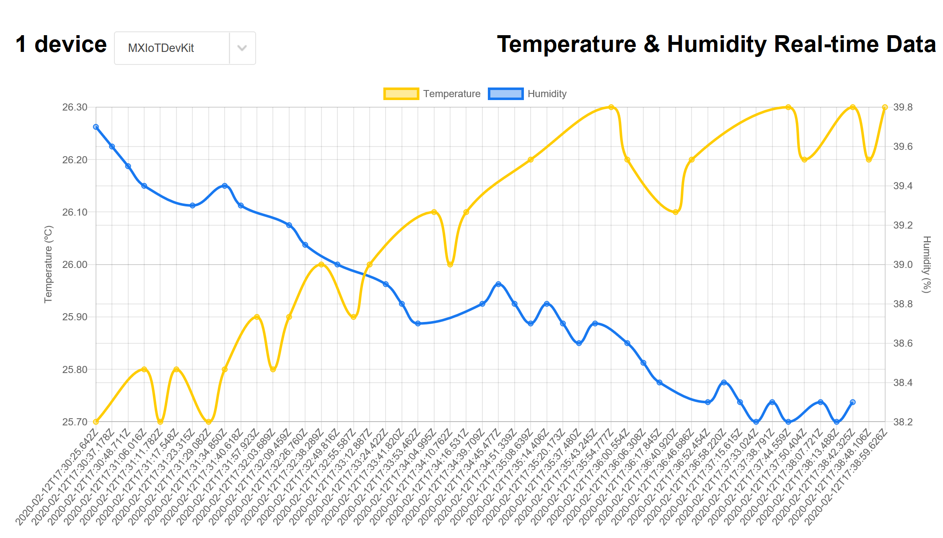
Hackathon IoT & AI Scenario – Part IV
Challenge: Visualize sensor data in a web application
Duration: 60 minutes
Hints and helpful resources:
Decide which platform to use for your web application. SCP, Azure, ….?
Depending on your choice, take a look at the sample application for ASP.NET at https://docs.microsoft.com/en-us/azure/iot-hub/iot-hub-live-data-visualization-in-web-apps
Or try out a Fiori app on SCP using the Chart (VizFrame) control

Slide 22


Thanks!

